Slide 1
Optimizing Writing Lab Sessions
Spring 2019 | Eliza Van, Isaac Wang, Carly Rae Zent, Seven Dawson
Notes:
Subtitle format: Date | Name of Facilitator / Faculty Member

Slide 2
Types of Writing Lab Sessions
Notes:
Hi! Welcome to the Writing Lab workshop on how to optimize the services we offer.
Today, we are going to walk you through the services the writing lab offers, talk about how to best use your session, and finally discuss how you can keep developing your writing skills after the session ends.
We will also include time at the end to address any specific questions you have. So let’s jump right in!

Slide 3
Types of Writing Lab Sessions
We can help you with any document, any stage of the writing process!
Face-to-face tutoring
Online tutoring (Live chat)
If you need help with grammar, we don’t edit, but we definitely can work with you!
E-tutoring
(Send a document to be looked at)
Notes:
Here at the writing center, we offer three ways to get tutored: Face to face sessions, online tutoring, and e-tutoring.
With face to face tutoring, you will be meeting with one of our tutors at one of our physical locations (Heavilon Hall or one of our satellite locations)
For online tutoring, you’ll be working with a tutor in real time via chat.
With e-tutoring, you can submit your word document using the scheduling software, and then have a tutor give you feedback. Just to clarify, this does not mean the tutor edits.

Slide 4
Face-To-Face Tutoring
Communicate your priorities at the beginning of the session
Share what has worked for you in the past
Communicate what you’re struggling to understand throughout the session
With face-to-face, you meet with tutors in person. This type of tutoring has the fewest limitations for most people
Notes:
Besides the logistical tips we already gave you, one of the best ways to make use of your face-to-face tutoring is to communicate with your tutor. Let them know your priorities so you can set a good agenda for the session. Share what has worked for you in the past, so the tutor doesn’t waste time on strategies that may not work for you. Be honest about whether you’re understanding.

Slide 5
Understand the limitations of online tutoring: Typing speed, time management, communication)
Use the beginning of the session to express your writing concerns and build an agenda with your tutor
Take advantage of WCO features: Drawing, access to transcripts after the session, highlighting
Online Tutoring
In online tutoring, you will upload a document, then at the scheduled time you will live chat with the tutor about the document
Notes:
Online tutoring involves uploading a document that you and the tutor will discuss at the scheduled time via the chat platform in WCO. This is a great option for students who take classes online and live far from school, or students who are uncomfortable coming into the physical lab for whatever reason. But there are limitations: typing is not as fast as talking. And communication without body language can be limiting.

Slide 6
E-Tutoring
Type out your concerns and priorities when you upload the document, as they will not be able to ask you questions
Understand the tutor only has the session length to work on your document
Take advantage of the fact that you can upload the document up until the time of the session
If you choose e-tutoring, you will upload a document and then at the chosen time the tutor will make comments and upload their version
Notes:
E-tutoring does not involve live chat. You will upload the document, and then at the scheduled time, the tutor will take the session time to give feedback on your document and upload their feedback for you.
As you will not be able to speak with the tutor, be sure to provide detailed information on your concerns about the document.
Like normal tutoring, you can schedule sessions ahead of time. In this case, you would just upload the document at any time before the session is scheduled to start. That means you can schedule a session for a document you know you need help on, then work on it until the session time.

Slide 7
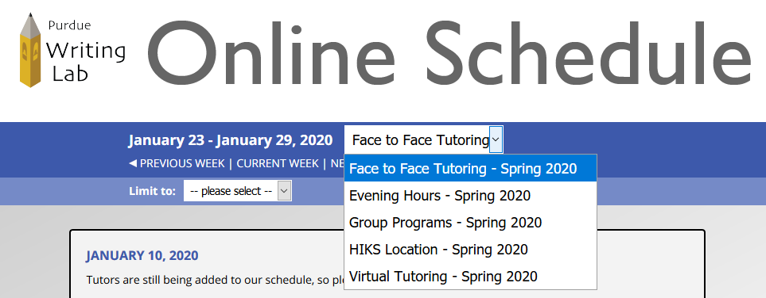
Navigating the Schedule with WCOnline
Select which schedule you want to make an appointment:
Notes:
Navigate to https://purdue.mywconline.com/ and login. You will be brought to a schedule page. There’s a drop down menu where you can select the different schedules. There’s face-to-face, evening hours, group programs, like conversation group, the HIKS location, and virtual tutoring, which consists of both Online and E-Tutoring.

Slide 8
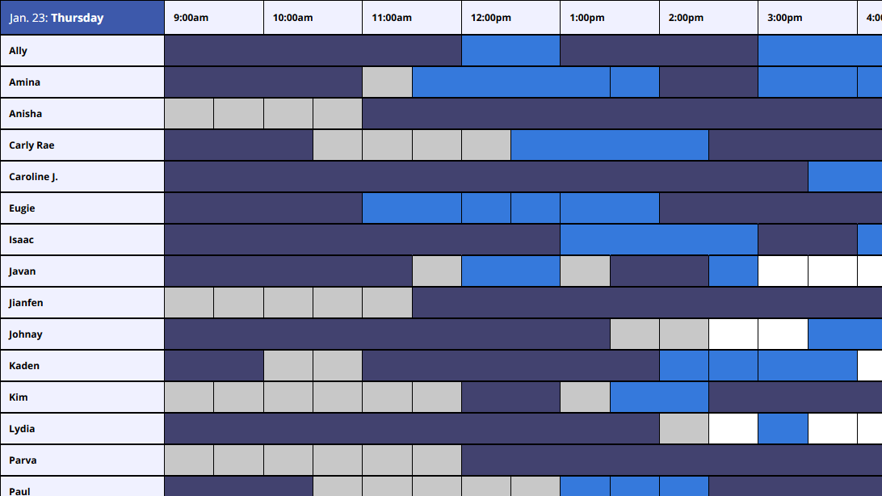
Navigating the Schedule with WCOnline
Open slots are white
Tutor’s names
Notes:
Once you’ve selected the appropriate schedule, you can make an appointment with the tutor of your choice.

Slide 9
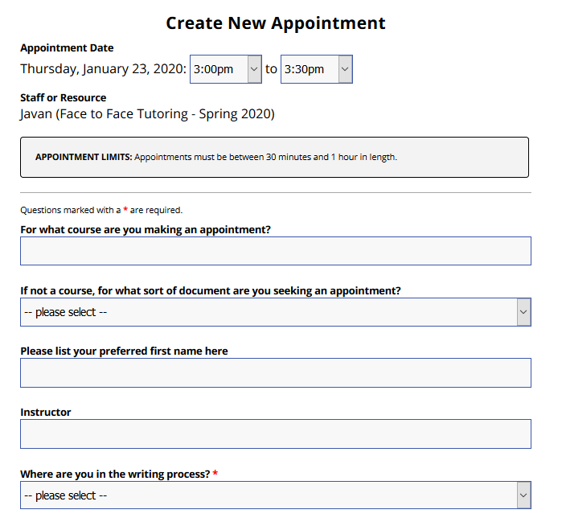
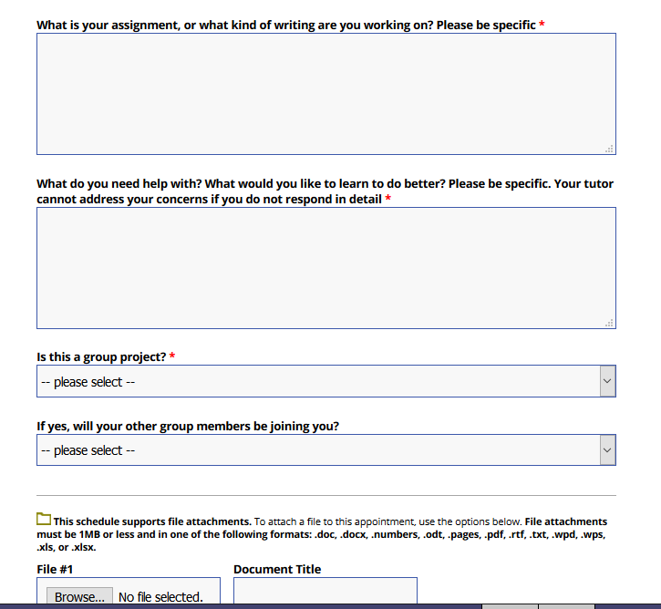
Navigating the Schedule with WCOnline
Notes:
When making the appointment, you can enter your preferred name and answer questions about your concerns. Be sure to fill in as many details as possible. As a tutor, I look at this before going into a session to get an idea of where to start. You can also upload documents here, but most of the time tutors will not have time to fully read the document before the session.

Slide 10
Choosing a Session Length
Choosing an hour is best while you’re becoming familiar with the writing lab
Choose a half-hour appointment for quicker concerns, i.e., formatting and other non-generative work
Break up longer documents into multiple sessions
Notes:
When you’re first getting started at the writing lab, you’re probably going to want to

Slide 11
How to Prepare for a Session

Slide 12
Choosing a Tutor
Every tutor is trained to work on most documents
Try out different tutors to determine which tutoring styles are best for you
Filter between graduate and undergraduate tutors in WCO
Read tutor profiles in the Writing Lab newsletter
Notes:
There are so many tutors, it can be hard to know who to choose. The good news is, whether you’re writing a dissertation or an essay for first-year composition, all our tutors are trained to be able to work on all types of documents. However, different tutors may have different tutoring styles. It’s worth trying out different tutors to see what styles work best for you.

Slide 13
Logistics before a Session
Other Tips:
Consider scheduling appointments in advance, especially around busy weeks of the semester.
Schedule appointments with substantial time before due dates
Take traffic/travel into account
Purdue
Come to session early (aim for ten minutes)
Consider bringing printed copies of your work
Have your Purdue ID with you
1
2
3
Notes:
In order to best utilize every minute of your session, you don’t want to miss part of it because you arrived late, or you had technical issues, or you spent session time printing work. Come early, have your Purdue ID.
You can also schedule sessions in advance if you know you will need help with an upcoming project. It’s also useful to schedule with substantial time before the deadline. If you schedule a session two hours before the deadline, you won’t have time to revise the document according to the tutor feedback.

Slide 14
Creating Realistic Expectations
Choose a 30-minute and 60-minute appointment based on your needs
Tutors will most often focus on Higher Order Concerns before Lower Order Concerns
Understand that not every writing concern can always be addressed in a single session
Notes:
A tutoring session is meant to be part of a process of improving your writing skills over time. It’s good to have realistic expectations about how much can be addressed in a 30 or 60 minute appointment. As tutors, we’re trained to address higher order concerns, like structure and content, first. Once those are done, we can focus on lower order concerns like grammar and spelling.

Slide 15
How to Continue Learning after the Session

Slide 16
Building Error Logs
Keep a private document where you track your common writing errors and their individual revisions
Include larger writing concepts like thesis statements and topic sentences and smaller errors like grammatical error patterns
Study your error own errors and model your future writing from the revisions you’ve made
Notes:
Building error logs are a great way to track your writing weaknesses and understand the areas that require the most work.

Slide 17
Practicing Skills You’ve Learned
Reflect on what you felt was most helpful in the session, so you can ask for that next time
Go over session notes (both own and tutor’s) soon after the session, so you can more easily internalize them

Slide 18
Follow-Up Appointments
Address additional concerns or work on later stages of the document with follow-up appointments
Making appointments with the same tutor can be advantageous for deeper understanding
Making appointments with a different tutor can help you get additional perspectives
Notes:
Follow-up appointments are useful for you and rewarding for the tutor. We like seeing documents and writing skills grow over time, and it’s a great way to keep up your learning.

